Slide 1
FIFA 2019 Player Data
Group 8
Christina Hartnett, Ronak Dilip Shah, Joshua Foote,
Stephanie Taboada and Michael LaBarbera

Slide 2
Background Information
Our data set has 188 players and 10 variables about each of these players
This set has 4 useful/ insightful categorical data columns
Some important variables we might want to use to analyze this data are wage, nationality, club, position, height and weight
Data Dashboard
Code for our project

Slide 3
Hypothesis 1
Student's T test
For our first test thought it would be interesting to test the hypothesis that Manchester United players mean wage is greater than that of all other club players.
H₀: μ_{MAN} = μ_{ALL}
H_{a}: μ_{MAN}> μ_{ALL}

Slide 4
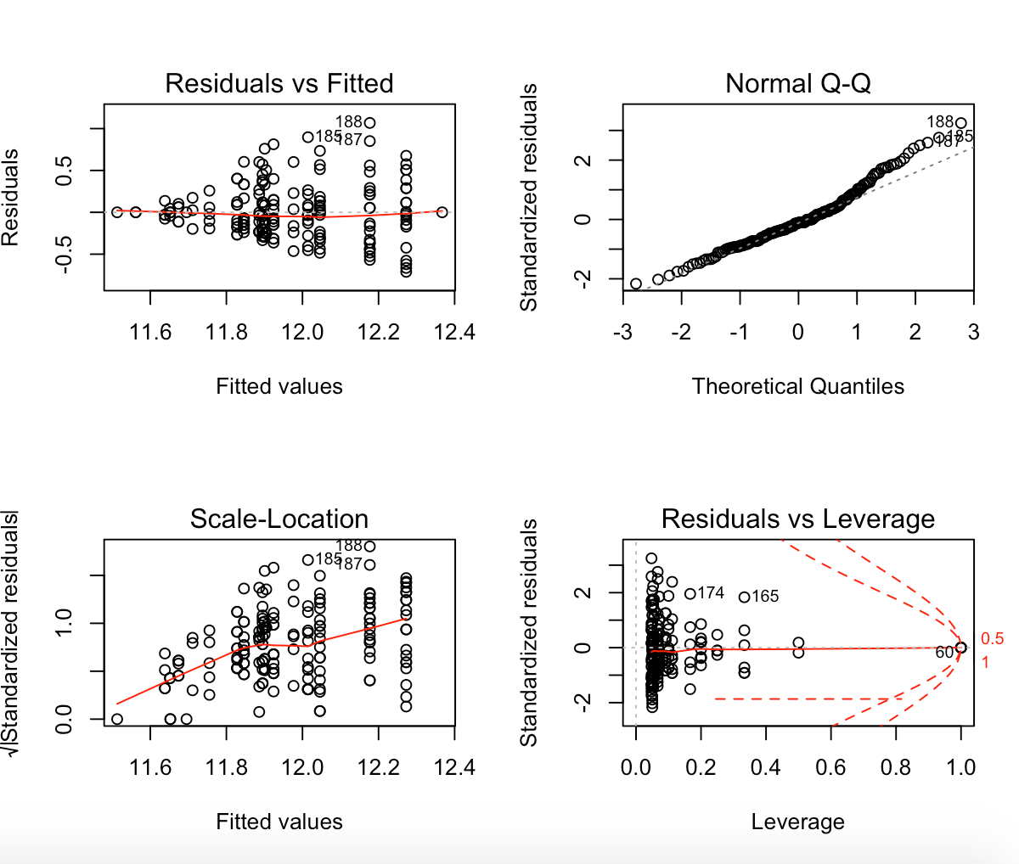
Checking assumptions
As we can see the data, once we take the log, is approximately normally distributed. Using the fact that we have large sample sizes we can use also assume normality by CLT.

Slide 5
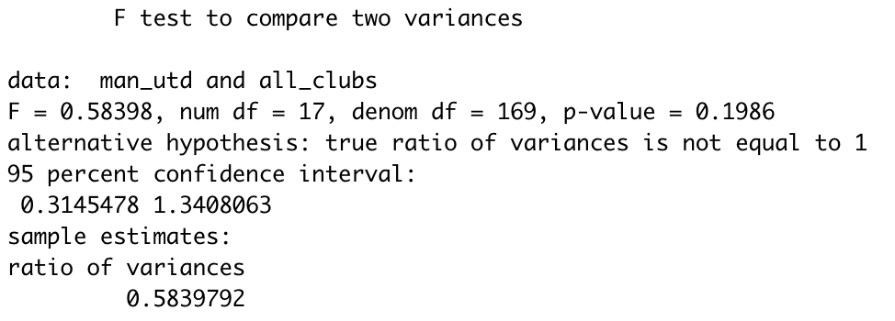
F test for comparing Variances

Slide 6
Steps for testing
For our first test we will be testing the 1- sided alternative hypothesis to check if the mean wage for Manchester United is greater than the mean wage for all other clubs
Sample size is greater than 30 (n > 30) for all other clubs so we may assume their wages are approximately normally distributed by the Central Limit Theorem, which agrees with our QQplot
We used a QQplot in order to make sure the normality assumption is met, we easily could have also checked this assumption with a Shapiro-Wilk test
MU
Sample size: 18
Max Wage for ST: 260,000
Min Wage for ST: 105,000
Mean Wage for ST: 152,500
SD of Wage for ST: 46,849.25764
All Others
Sample size: 170
Max Wage for ST: 565,000
Min Wage for ST: 100,000
Mean Wage for ST: 170,147.0588
SD of Wage for ST: 77,725.48125

Slide 7
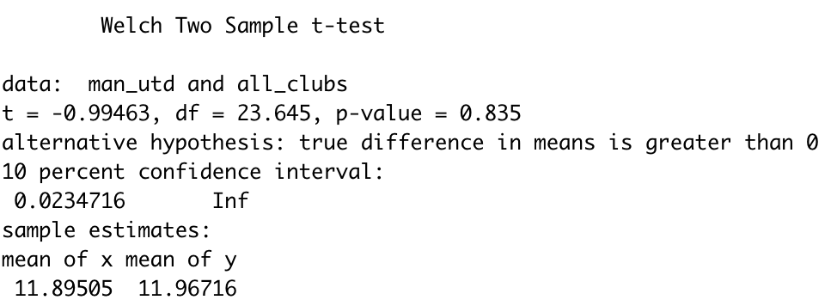
T test in R- using log of wage

Slide 8
Conclusion
Our conclusion is not reject the null Hypothesis (H₀: μ_{MU} = μ_{ALL}) because our p-value is .835 which is greater than our alpha we were testing against.
This means that we do not have enough evidence to claim that the wage for Manchester United players is higher than that of all other clubs

Slide 9
Another Hypothesis 1
Student's T test
From the last test we expected the null Hypothesis to be rejected in favor of the alternative, but as we saw this did not happen. On a smaller scale, we decided it would be interesting to test if the the mean wage of Manchester United players is greater than that of Manchester City players at alpha level .1
H₀: μ_{MU} = μ_{MC}
H_{a}: μ_{MU}> μ_{MC}

Slide 10
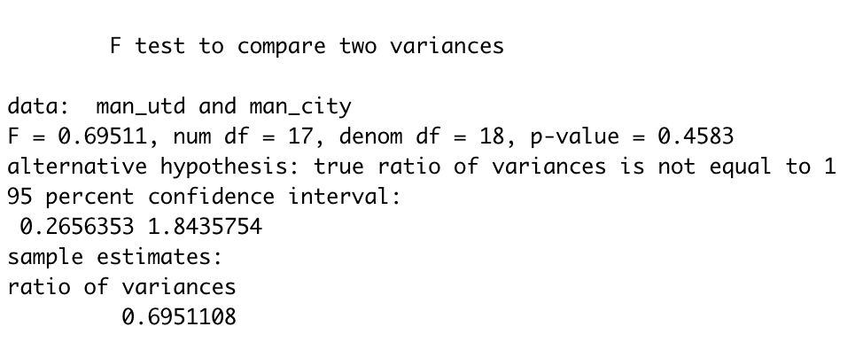
F test for comparing Variances

Slide 11
Steps for testing
For our first hypothesis we will be testing the 1- sided alternative hypothesis to check if the mean wage for Manchester United is greater than the mean wage for Manchester City
We know the data is normally distributed and that the variances are equal shown by the F test
MU
Sample size: 18
Max Wage for ST: 260,000
Min Wage for ST: 105,000
Mean Wage for ST: 152,500
SD of Wage for ST: 46,849.25764
MC
Sample size: 19
Max Wage for ST: 355,000
Min Wage for ST: 105,000
Mean Wage for ST: 180,526.3158
SD of Wage for ST: 67,616.04709

Slide 12
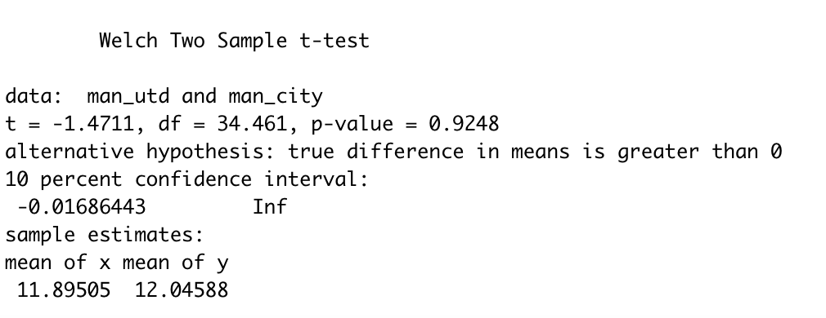
T test in R using log of wage data

Slide 13
Conclusion
Our conclusion is not reject the Null Hypothesis (H₀: μ_{MU} = μ_{MC}) because our p-value is 0.9248 which is greater than our alpha we were testing against.
This means that we do not have enough evidence to claim that the wage for Manchester United players is higher than that of Manchester City players.

Slide 14
Hypothesis 2
Chi-Squared test
Our second Hypothesis we decided to test is if the Zone of origin and Position of the players are dependent at alpha level 0.1
Our Null Hypothesis is that the zone of origins have the same average number of players per position.
Our Alternative Hypothesis is that the average number of players per position is dependent on the zone they originate from

Slide 15
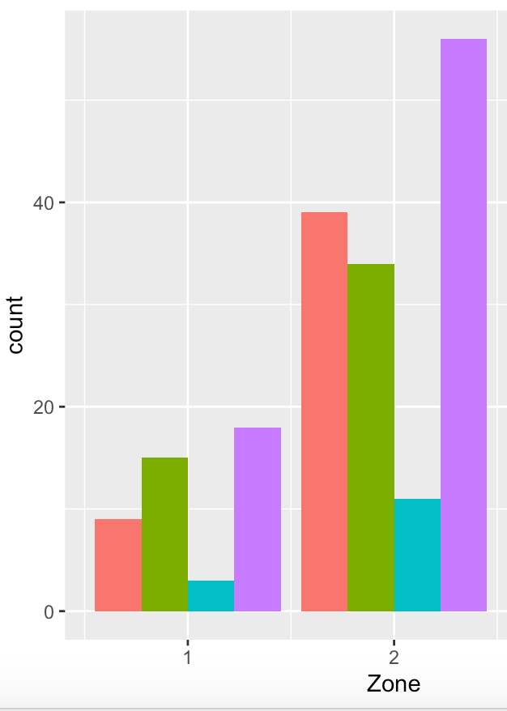
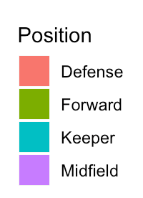

Slide 16
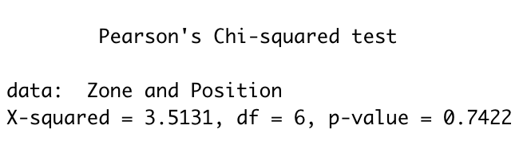
Zone 1 (Americas):
N= 45
Probability of:
Defense: 0.2
Forward: 0.33333333
Keeper: 0.06666667
Midfield: 0.4
Zone 2 (Europe/Africa):
N= 140
Probability of:
Defense: 0.27857143
Forward: 0.24285714
Keeper: 0.07857143
Midfield: 0.4

Slide 17
Conclusion
Our conclusion is to not reject the Null Hypothesis because our p-value is larger than the alpha level.
0.7422 >.1
So there is insufficient evidence to claim that the proportion of players per position differs depending on the zone of origin.

Slide 18
Anova- Hypothesis 3
We wish to test if the mean weights for at least one club differs from the others. The clubs we tested are Manchester United vs. Chelsea vs. FC Barcelona vs. Juventus
H₀: μ_{MU} = μ_{C}= μ_{B} = μ_{J}
H_{a}: At least one of the mean weights does not equal

Slide 19
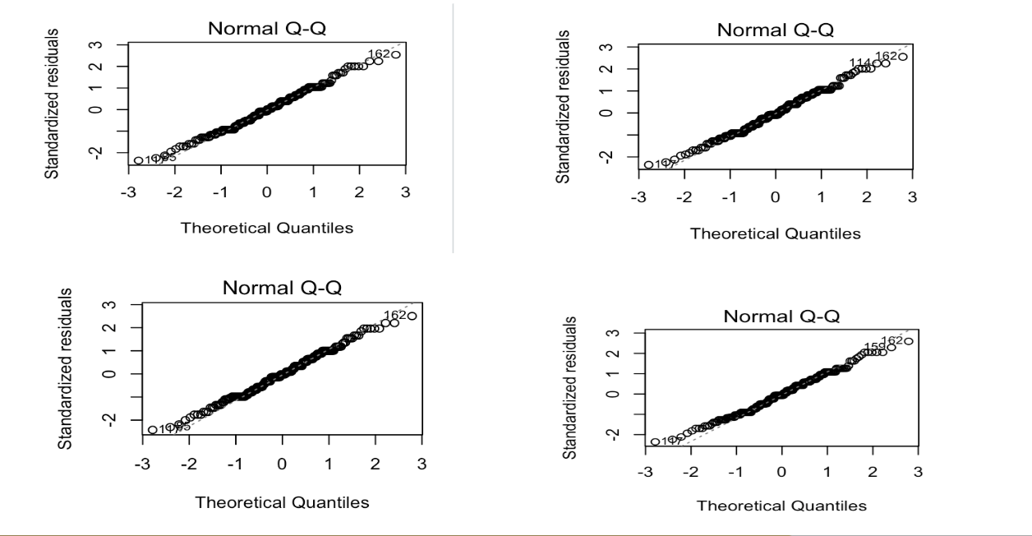
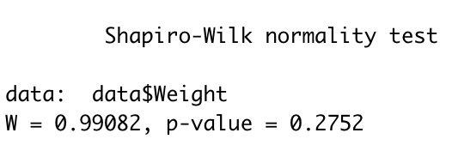
Checking assumptions- testing normality

Slide 20
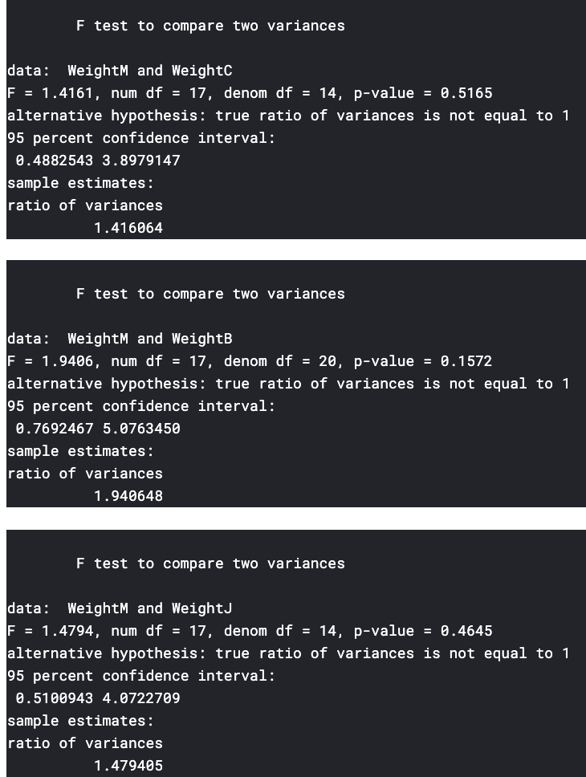
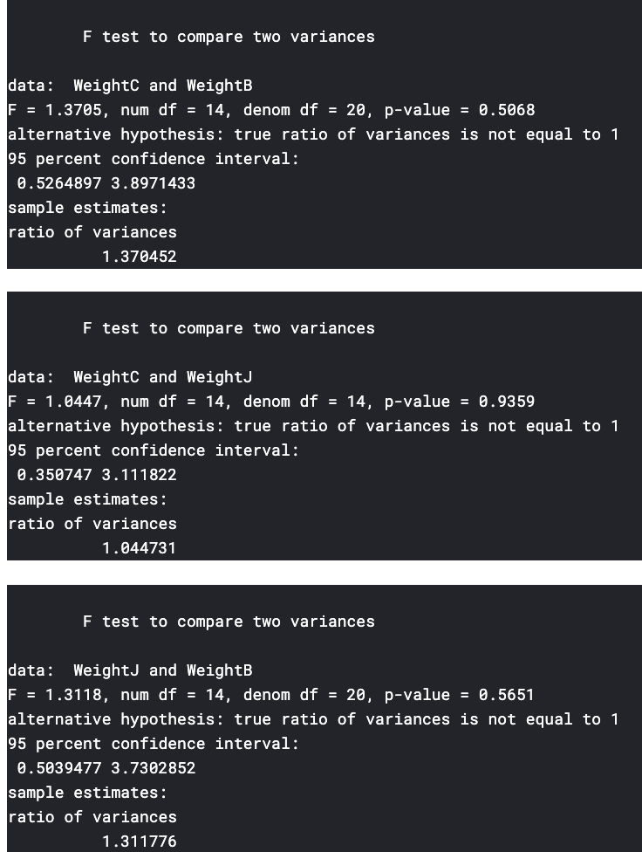
Testing Equal but unknown variances

Slide 21
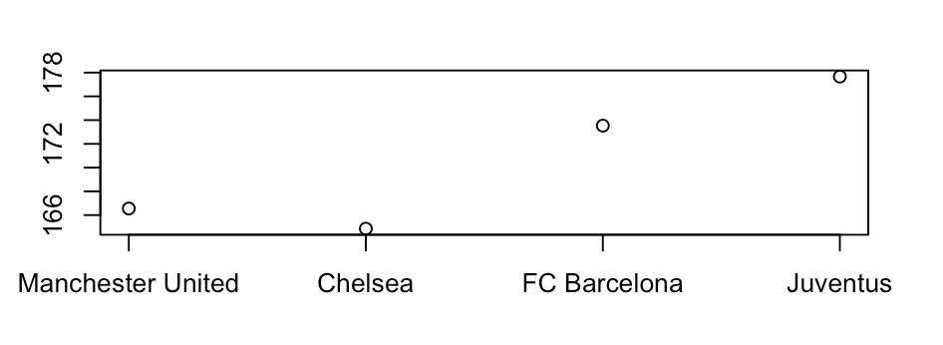
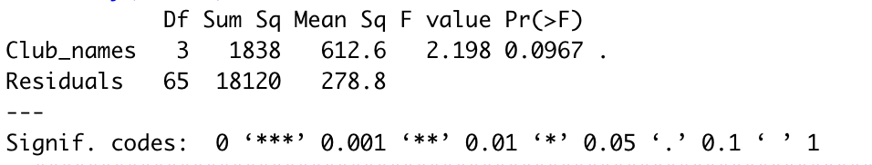
Our means weights of Manchester United, Chelsea, FC Barcelona and Juventus players are graphed to the left

Slide 22
Conclusion
Our conclusion is to reject the null hypothesis in favor if the alternative hypothesis (p-value is less than the alpha level).
0.0967 <.1
So there is sufficient evidence to claim that at least one mean weight does not equal among the 4 clubs (Manchester United, Chelsea, FC Barcelona and Juventus)

Slide 23
Hypothesis 4
Generalized Linear Model
For the Generalized Linear Model test we tested if the Wages are dependent on zones of origin or preferred foot at alpha level .1
Ho = Wages of the players are independent on their zone of origin and their preferred foot
Ha = Wages of the players are dependent on their zone of origin and their preferred foot

Slide 24
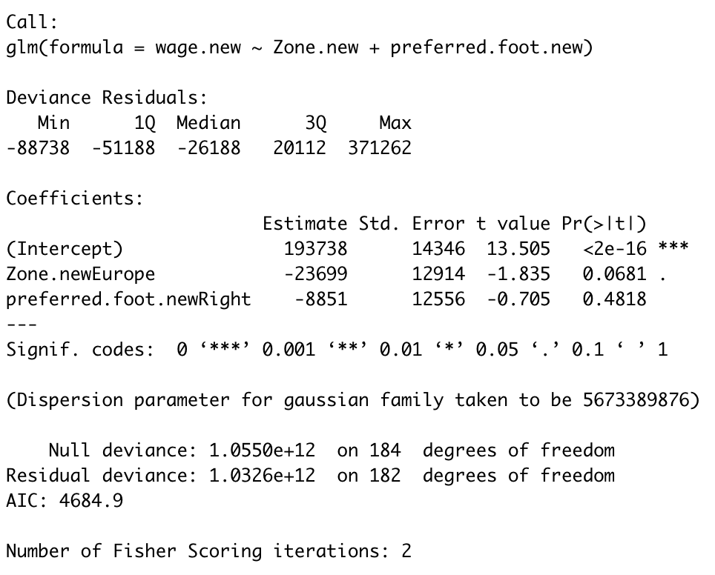

Slide 25
Conclusion
Our conclusion is to reject the null hypothesis in favor of the alternative for zone, meaning that wage is dependent on zone
but we will fail to reject the null hypothesis for preferred foot, claiming that the wage does not depend on the preferred foot of the player
Zone: 0.0681 < .1
Preferred Foot: 0.4818 > .1

Slide 26
Hypothesis 5
Generalized Linear Model
We ran the GLM distribution test on the same set of data with random missing values. For the test, 20% of the player wages values were set to “NA.” The missing values were randomly selected.
Ho = Wages of the players are independent on their zone of origin and their preferred foot
Ha = Wages of the players are dependent on their zone of origin and their preferred foot

Slide 27
Replacing missing values & Non-ignorable missing values
For our first test with missing values we decided to fill in all NA’s with the mean value of our wages
For the second test we replaced the missing values with the median value of the wages
When given non-ignorable missing data we cannot just replace the data with the mean or median. This non-ignorable missing data can change our whole conclusion, which makes the analysis extremely misleading.
One reason data might be missing in the wage column is because of insecurities of players with wages lower than that of their teammates/ competitors (if enough data of low wages is missing the data might appear normal when in reality it would be skewed)

Slide 28
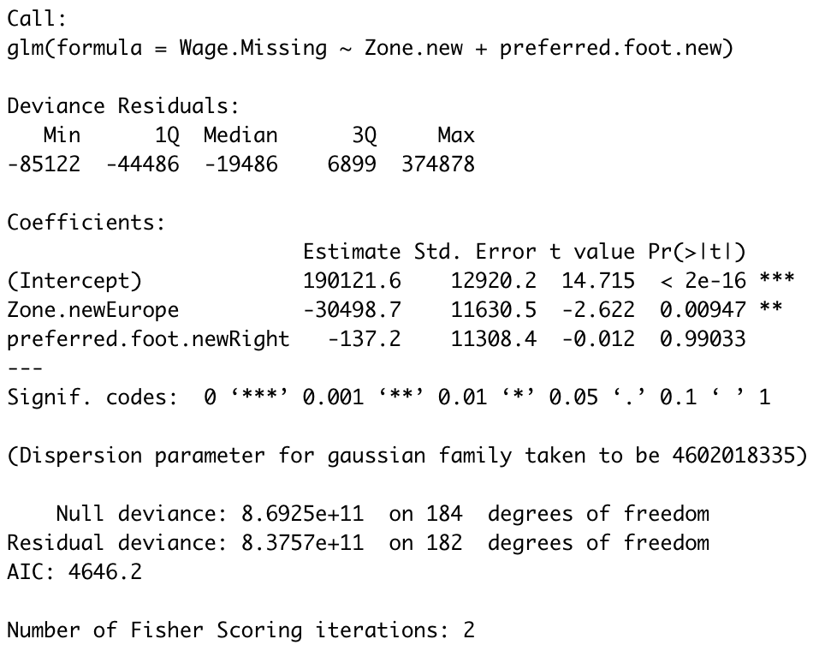
Replacing NA’s with mean of Wage

Slide 29
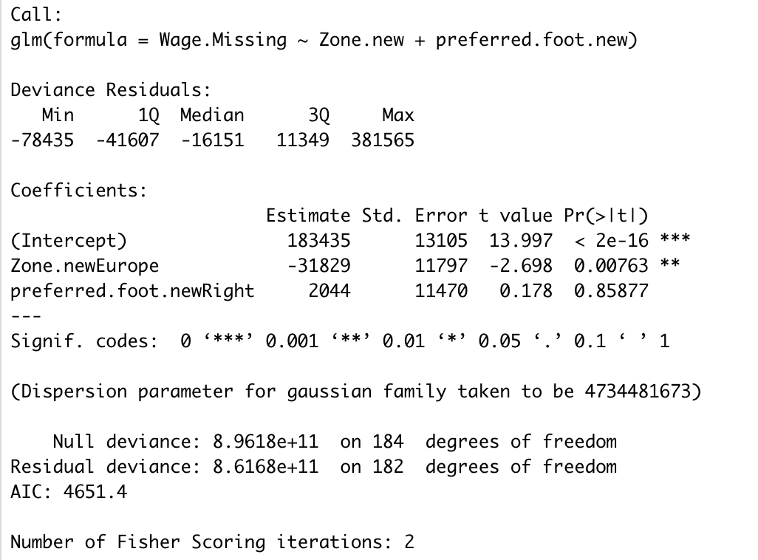
Replacing NA’s with Median of Wage

Slide 30
Conclusion
Our conclusion for both is to reject the null hypothesis in favor of the alternative for zone, meaning that wage is dependent on zone but again we will fail to reject the null hypothesis for both mean and median on preferred foot, claiming that the Wage does not depend on the preferred foot of the player. This is the same conclusion as we saw with the original GLM but the zone p-value has decreased significantly in both mean and median and the preferred foot value has about doubled in both.

Slide 31
install.packages("caret")
install.packages("datatable")
install.packages("mltools")
install.packages("Hmisc")
install.packages("ggplot2")
library(caret)
library(data.table)
library(mltools)
library(Hmisc)
library(ggplot2)
ams572_2 <- read.csv("./Desktop/AMS 572 FINAL CODE 2.csv", header =TRUE)
data <- ams572_2
data$Wage1<-(log(data$Wage))
#### Check for normal distribution for wage
qqnorm(data$Wage1)
par(mfrow=c(2,2))
###plot for normal QQ looks fairly straight so assume normality is met
plot(lm(data$Wage1~data$Club))
#### Mean wage of Man. Utd vs Man. City using T-test
man_utd <- data$Wage1[data$Club == "Manchester United"]
man_city <- data$Wage1[data$Club == "Manchester City"]
#Equal Variances bc P-value is greater than alpha level
var.test(man_utd,man_city)
##fail to reject null hypothesis
t.test(x=man_utd, y=man_city,alternative = "greater", conf.level = 0.1)
#### Mean wage of Man. Utd vs all using T-test
man_utd <- data$Wage1[data$Club == "Manchester United"]
all_clubs <- data$Wage1[data$Club != "Manchester United"]
#Equal Variances bc P-value is greater than alpha level
var.test(man_utd,all_clubs)
##fail to reject null hypothesis
t.test(x=man_utd, y=all_clubs,alternative = "greater", conf.level = 0.1)
##Extra information about the data
mean(data$Wage[data$Club == "Manchester United"])
sd(data$Wage[data$Club == "Manchester United"])
min(data$Wage[data$Club == "Manchester United"])
max(data$Wage[data$Club == "Manchester United"])
mean(data$Wage[data$Club == "Manchester City"])
sd(data$Wage[data$Club == "Manchester City"])
min(data$Wage[data$Club == "Manchester City"])
max(data$Wage[data$Club == "Manchester City"])
mean(data$Wage[data$Club != "Manchester United"])
sd(data$Wage[data$Club != "Manchester United"])
min(data$Wage[data$Club != "Manchester United"])
max(data$Wage[data$Club != "Manchester United"])
#### chi sq test for zones vs the position
Position<- data$New_Position
Zone<- data$Zone
Zone1<- Zone[Zone== 1]
Zone2<- Zone[Zone== 2]
Z1<- Position[Zone== 1]
(length(Z1[Z1== "Midfield"])/length(Z1)) #percentage of Midfield from Z1
(length(Z1[Z1== "Defense"])/length(Z1)) #percentage of Defense from Z1
(length(Z1[Z1== "Forward"])/length(Z1)) #percentage of Forward from Z1
(length(Z1[Z1== "Keeper"])/length(Z1)) #percentage of Keeper from Z1
Z2<- Position[Zone== 2]
(length(Z2[Z2== "Midfield"])/length(Z2)) #percentage of Midfield from Z2
(length(Z2[Z2== "Defense"])/length(Z2)) #percentage of Defense from Z2
(length(Z2[Z2== "Forward"])/length(Z2)) #percentage of Forward from Z2
(length(Z2[Z2== "Keeper"])/length(Z2)) #percentage of Keeper from Z2
chisq.test(Zone,Position)

Slide 32
### ANOVA ###
WeightM<- data$Weight[data$Club== c("Manchester United")]#weights for Manchester United players
WeightC<- data$Weight[data$Club== c("Chelsea")] #weights for Chelsea players
WeightB<- data$Weight[data$Club== c("FC Barcelona")] #weights for FC Barcelona players
WeightJ<- data$Weight[data$Club== c("Juventus")] #weights for Juventus players
##checking normality
par(mfrow=c(2,2))
plot(lm(data$Weight~data$Club== c("Manchester United")))
plot(lm(data$Weight~data$Club== c("Chelsea")))
plot(lm(data$Weight~data$Club== c("FC Barcelona")))
plot(lm(data$Weight~data$Club== c("Juventus")))
shapiro.test(data$Weight)
#Testing Variance
var.test(WeightM,WeightC)
var.test(WeightM,WeightB)
var.test(WeightM,WeightJ)
var.test(WeightC,WeightB)
var.test(WeightC,WeightJ)
var.test(WeightJ,WeightB)
mean_amt <- c(mean(WeightM),mean(WeightB),mean(WeightC),mean(WeightJ))
Club_name <- c('Manchester United','Chelsea', 'FC Barcelona','Juventus')
plot(mean_amt, xlab = "Club", ylab = "Mean amount", xaxt='n', ann=FALSE)
axis(1, at= 1:4, labels=Club_name)
M<- length(WeightM) #how many players for Manchester United
C<- length(WeightC) #how many players for Chelsea
B<- length(WeightB) #how many players for FC Barcelona
J<- length(WeightJ) #how many players for Juventus
Weights<- c(WeightM, WeightC, WeightB, WeightJ)
Club_names <- rep(c('Manchester United','Chelsea', ‘FC Barcelona','Juventus'),c(M,C,B,J))
fitAOV<- aov(Weights~Club_names)
summary(fitAOV)

Slide 33
## GLM ###
attach(data)
Zone[which(Zone==2)]= "Europe"
Zone[which(Zone==1)] = "Americas"
Zone.new = Zone[which(Zone!=3)]
preferred.foot.new = Preferred.Foot[which(Zone!=3)]
wage.new = Wage[which(Zone!=3)]
fit1<- glm(wage.new~Zone.new + preferred.foot.new)
summary(fit1)
#ZONE IS SIG ON WAGE BUT PREF FOOT ISNT
#### effect of Missing value mean imputation
Wage.Missing = data$Wage.Missing
Wage.Missing = impute(Wage.Missing, mean)
Wage.Missing = Wage.Missing[which(Zone!=3)]
fit2 <- glm(Wage.Missing~Zone.new + preferred.foot.new)
summary(fit2)
#### effect of Missing value median imputation
Wage.Missing = data$Wage.Missing
Wage.Missing = impute(Wage.Missing,median)
Wage.Missing = Wage.Missing[which(Zone!=3)]
fit3 <- glm(Wage.Missing~Zone.new+preferred.foot.new)
summary(fit3)

